Slide 1

Analyzing Policy Gradient Methods for Rapid Policy Transfer
Thesis presentation - 30 November 2020
Presenter: Abhishek Mahadevan Raju
Supervisor: Dr. Joaquin Vanschoren
Department of Mathematics and Computer Science
Data Mining Research Group
Notes:
Hi! My name is Abhishek Mahadevan Raju, and today I’ll be presenting my thesis on Analyzing Policy Gradient Methods for Rapid Policy Transfer.

Slide 2
Background
Artificial General Intelligence (AGI) – introduced in the 1950s
Historical Focus
      Knowledge Representation Approaches
      Interaction-based Approaches (Classical RL)
  Artificial Intelligence - Generating Algorithms (AI-GAs)
      Neural Architecture Search (NAS)
      Meta-learning
      Generating efficient training environments
Notes:
Artificial General Intelligence or AGI is a concept that first arose in the 1950s, approximately near the Golden Age of Science Fiction. The fundamental idea is that a machine can be constructed with the capacity to reason and act similar to that of humans.
Historically, this idea was approached as a task of knowledge representation – it was believed that all basic human knowledge and common sense could be encoded in the form of syntactical knowledge, that an algorithm would learn to utilize effectively to make sequential decisions and actions.
It only took a couple of decades to realize that this idea was wildly optimistic – and research was quickly dropped in favour of projects that seemed more likely to succeed.
Around the same time, in the field of robotics, optimal control was gaining ground as an effective strategy towards reaching objectives, leading to the development of interaction-based decision making algorithms, a field called Reinforcement Learning. These algorithms were designed to solve small problems by trial-and-error, gradually learning to choose certain sequences of actions over others.
The birth of modern deep learning to approximate more and more complex functions has led to a requirement for a modern theory of Artificial General Intelligence. Jeff Clune in 2019 proposed such a theory in the form of AI Generating Algorithms or AI-GAs. In AI-Gas, there are 3 major pillars, 2 of which are well-researched.
Neural Architecture Search involves training a model to identify the best possible model architecture for a new task.
Meta-learning attempts to generalize learning across a set of tasks to rapidly learn how to perform well on newer unseen tasks.
Generating efficient training environments is a requirement to train an agent to quickly and effectively learn to act optimally towards a new objective.
Generating efficient training environments is not well-researched, and is the hardest pillar to formalize. While it is quite hard to learn to do this for many environments, it should ideally be possible to do this for a single environment. Thus, in our work, we attempt to solve this problem in the perspective of Reinforcement Learning, and reframe the problem statement as that of rapidly transferring an optimal policy to an agent.

Slide 3
Research Questions
Design a framework to create efficient training environments
Evaluate framework
Identify limitations of framework and suggest solutions
Notes:
Our research questions are thus as follows-
How do we devise a framework to train towards this objective?
How do we test whether this framework is training an optimal policy transferring model, which we call the Trainer model.
What limitations will this framework face?
Before going into the details of the framework, I’ll first explain some underlying methods used.

Slide 4
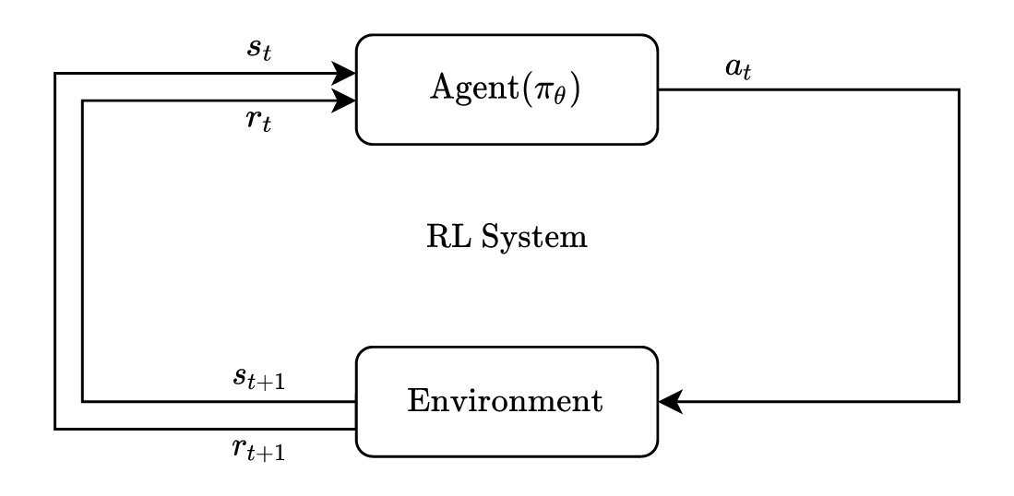
Reinforcement Learning
Paradigm for sequential-decision making through machine learning models.
Agent learns to achieve a defined objective in an uncertain, complex environment.
Notes:
Reinforcement Learning stands apart as a pillar of Machine Learning that optimizes sequential decision-making towards a final goal.
In essence, we train an agent or actor, to perform a sequence of actions that leads to a maximized total reward.
We see this in the figure as a feedback loop. At every timestep, the agent receives the current state of the environment, and the reward obtained in the previous step, and it decides an action to perform. RL environments are generally considered unknown and complex, and the training is guided completely by the reward objective.
The general RL scenario can best be understood in the context of an example.

Slide 5
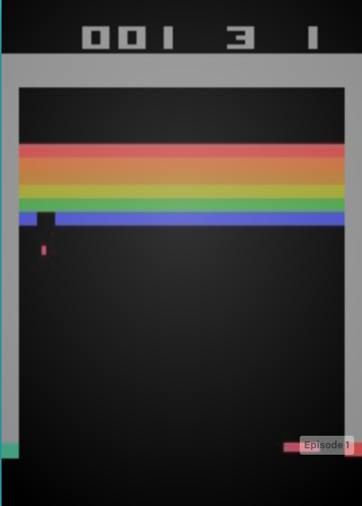
Example – Reinforcement Learning
Atari Breakout environment.
Policy – Algorithm used by Agent to decide actions given current state
State – (210, 160, 3) image per step
Action – [‘NOOP’, ‘FIRE’, ‘LEFT’, ‘RIGHT’]
State Space Types
Action Space Types
Environment – Atari Game Engine
Trajectory – State, Action sequence
Agent – Algorithm that performs actions in the environment.
Low-level
Discrete
Continuous
High-level
Notes:
The Atari Breakout game is a classic arcade game in which the player must clear the screen of blocks, with the help of a ball that must be bounced upwards. The player has control over the platform below, and can either move left or right, or stay in the same place. There is also an action to fire the ball, which is used to start the game.
As an environment for RL, the environment has the following features.
The state of the environment is an image of dimension (210, 160, 3), and is considered a high-dimensional state.
The actions of the environment are discrete actions in the set NOOP, FIRE, LEFT or RIGHT, and it is thus a discrete action environment.
The environment itself as an entity is the game engine that reacts to the actions that we take.
We get rewards when we break blocks, and the longer we survive.
The player in the RL scenario is called the agent, since it performs the actions.
It chooses those actions in accordance with an algorithm called the Policy, which identifies a state-to-action mapping function.
A low-dimensional state-space would correspondingly be a 1-dimensional vector of variables describing the environment
If the actions could take any decimal value within a specified range, it would be called a continuous action environment.
Modern RL uses deep neural networks as the function approximators in the policy, and this is a field known as Deep Reinforcement Learning.
The parameters of the neural network are the parameters of the policy.

Slide 6
RL Algorithm Classifications
Based on presence of Model
RL Policy Types
Stochastic
Deterministic
Output is probability of choosing each action
Output is direct action value
Model-free
Model-based
Learns a policy through interactions and experience
Learns both a policy, and a surrogate model of environment
On-policy
Off-policy
Learning happens from active interaction by the policy itself, and is incremental
Example : A2C, PPO
Learning occurs from a dynamically updated independent cache of memory samples
Example : DDPG, TD3, SAC
Notes:
Before we explore RL classifications, the types of RL policies must be known
There are two types, Stochastic and Deterministic
Stochastic policies produce an output which represent the parameters of a distribution from which the values are chosen.
In the case of discrete action spaces, a Categorical distribution is used.
In the case of continuous action spaces, a multivariate Gaussian distribution is used.
Sampling from these probabilities integrates the policy of exploring the environment by accommodating a degree of random actions.
On the other hand, deterministic policies give a direct action that the agent can use in the environment. To allow for exploration in this case, either a random probability of actions are chosen to be random, or noise is manually added to the actions chosen by the policy.
While there are other criteria for classification, one of the major ones is based upon whether a surrogate model is trained and used by the agent to simulate the environment, and guide its actions.
Based on this, we have either model-based or model-free algorithms.
Model-free algorithms learn entirely through interaction with the actual environment, and thus are able to experiment with more random actions.
In general, they are applicable towards more general use-cases, since they are not constrained in training.
Model-based algorithms simultaneously also train a surrogate model to predict the next state of an environment given the current state and a chosen action, and they use this to plan towards reaching the maximum reward. However, the performance of such algorithms is completely dependent upon the accuracy of the surrogate model itself.
Model-free algorithms are of two classifications based on how the experience is collected, respectively on-policy and off-policy algorithms.
On-policy algorithms train through incremental learning – they perform an entire trajectory of steps in the environment with a current policy, identify the loss and gradient to update the policy, and then in the next step, they gather information from the updated policy in the environment.
Off-policy algorithms on the other hand do not require such a connection, and the collection of experience samples is dynamically updated, and may be from policy different from the one being trained.

Slide 7
Genetic Algorithms
Gradient-free optimization
General Template
    Initialization
    Elitism
    Selection
    Genetic Operations
      Crossover
      Mutation
    Termination
Population
Notes:
Genetic Algorithms are one of the simplest types of evolutionary algorithms, and form a gradient-free method of optimization.
Such methods are usually ideal for use cases wherein there the objective is indirectly connected to the agent.
An implementation of such Genetic Algorithms was shown to have good results in tasks in the same domain, involving the optimization of millions of parameters, and thus we choose this method to optimize our Trainer as well.
A major drawback of such algorithms is the time taken to converge to the optimal solution.
The general template of Genetic Algorithms follows these steps.
First, a population of individuals is initialized. A set of individuals are uniformly chosen from across the possible space of parameters.
Next, these individuals are evaluated and sorted according to their average performances.
We then identify the top 50% of individuals and discard the bottom half, a process called Elitism.
To refill the population, a set of Individuals is to be chosen that shows enough diversity amongst the existing individuals, while also giving preference to the higher-ranked individuals. Methods commonly used for this process of Selection involve truncation selection and tournament selection.
Once these individuals are chosen, a suitable genetic operation is performed upon them to create hybrid individuals. In the process of Crossover, 2 parent individuals are chosen from the Selected set, and components of both parents are combined at random to form a child individual. In Mutation, a single parent Individual creates a hybrid child individual by adding some noise or perturbation to all its own parameters.
This process is repeated multiple times over multiple generations, until one of the individuals crosses a performance threshold, at which point this best performing individual is said to be completely optimized.

Slide 8
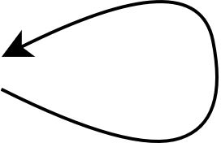
Meta-Learning (learning to learn)
Popular generalization approach
Optimize meta-parameters to make learning new unseen tasks faster
Outer loop
Meta-Parameters
Inner loop
Model Parameters
Model Parameters (influenced by meta-parameters)
Meta Loss
Loss
Batch data sample from a single supervised task
Batch trajectory data from a single RL environment
Batch trajectory data from multiple RL environments
Batch data samples from multiple supervised tasks
Notes:
Meta-learning refers to a generalization approach known as ‘learning to learn’, wherein a certain set of meta-parameters are tuned to optimize learning towards future objectives.
While meta-learning is a broad term encompassing many variations of meta-optimization, we consider a specific gradient-based form in our work.
This is demonstrated in the figure.
A usual neural network learning process for a single supervised learning task involves the following steps.
Model parameters are initialized. Data from the task is sampled in batches, and each step, an appropriate loss is calculated, and backpropagation over gradient descent is used to
Optimize the model parameters.
In the perspective of RL, our data gathering process differs. Instead of sampling fixed data, we gather a batch of trajectory data, of fixed or varying sizes from the environment, and calculate a special RL loss which adequately represents the loss that we obtain in performing suboptimal actions in the trajectory. A similar backpropagation loss works towards optimizing the model parameters, which in this case are policy parameters.
On the other hand, meta-learning in the supervised learning attempts to optimize certain meta-parameters which directly influence or set the model parameters while training across a variety of tasks. Two levels of training exist, the inner loop and the outer loop. The inner-loop generally optimizes temporary variables. The key point is that the model parameters in the inner loop are a direct function of the meta-parameters in the outer loop. In the inner-loop, we sample an equal amount of data from multiple tasks, and obtain a general loss across all these tasks. We thus perform 2 degrees of optimization. First, we perform gradient descent on the inner-loop model parameters based on the general loss. Next, we perform a second gradient-descent on the meta-parameters based on the change in the values of the model-parameters with respect to the value of the model parameters initially set by the meta-parameters.
The meta-parameters thus optimize towards setting the right model parameters.
In previous work that has been done upon generalizing training across multiple RL tasks, a similar change is done. The trajectory data in the inner loop is sampled from multiple RL tasks, and the loss calculation in the inner loop is based upon RL loss, identified from existing RL algorithms.
while gathering information from multiple tasks, we

Slide 9
Methodology
Modified meta-learning generalizing across learners than across tasks.
The loss function from the trajectory loss is a function of both meta-parameters and agent-parameters.
Outer loop
Meta-Parameters (Trainer)
(generates synthetic data)
Inner loop
Agent Parameters (trained once using generated data)
Meta Loss
Loss
Batch trajectory data from multiple agents in the same RL environment
Notes:
In our scenario, we attempt to reach the following objectives
First, we wish to generalize in one specific RL task, but across a range of actor model architectures.
Next, we wish to ensure that the meta-parameters perform rapid policy transfer on new agents. To ensure this, each time in the inner-loop, we initialize a new actor. We train this actor with exactly one step of Stochastic Gradient Descent upon synthetic data generated by the Trainer. The agent is then considered prepared, and is tested upon the actual environment.
The second-order loss in this case, the loss of the Trainer meta-parameters is the measure of how much divergence exists between the initial agent parameters (after one step of stochastic gradient descent) and the final agent parameters after being updated with respect to the RL loss obtained in the environment.

Slide 10
Methodology (Cont.)
Implementation details
Trainer Input/ Output Sampler
Outer loop
Trainer
Synthetic States
Actor
Cache
Inner loop
RL Loss Calculation
Algorithms
(Meta-loss)
Sampled Random Actor
Loss
Sample batch
Trajectory Data Sampling (from actual environment)
Notes:
The methodology is explained further in terms of the implementation that was done.
The Trainer model is initialized first.
In order to reduce the complexity of having to recreate Actors each inner loop, a cache of Actors with random architectures is pre-made beforehand
The noisy input to the Trainer model is also premade as a cache to sample from.
The sequence of training is as follows
First an actor is sampled in the inner loop from the Actor Cache
Next the Trainer model generates a set of synthetic states from a noisy input, and the sampled Actor is trained with one step of Stochastic Gradient Descent.
This Actor is then tested upon the actual environment, and trajectory data is obtained.
The RL loss calculation is done in this process, and is largely a direct implementation of usual state-of-the-art RL update algorithms with respect to the Actor.
The gradient of the change in the parameters in the Actor from the RL loss is used to update the Trainer meta-parameters.
The Trainer thus learns to optimize a randomly sampled Actor with random architecture within a single step of Stochastic Gradient Descent.

Slide 11
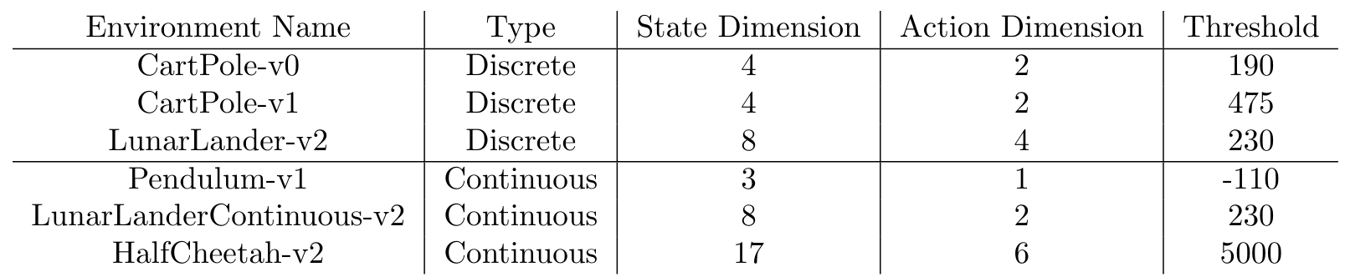
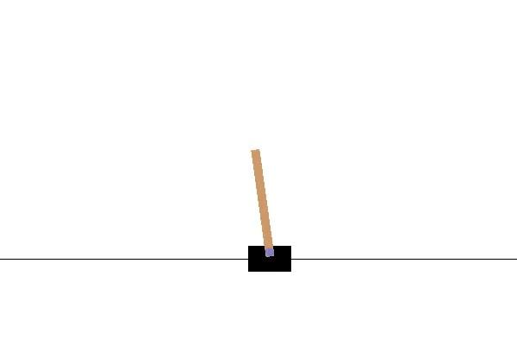
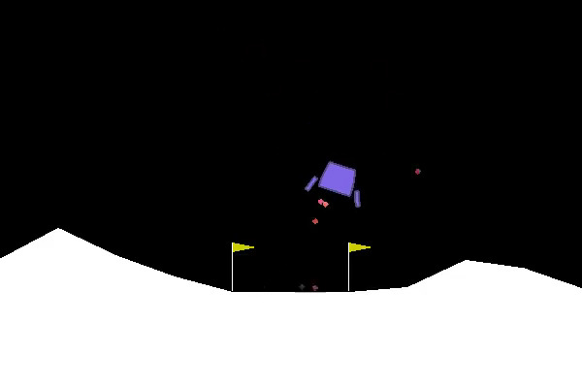
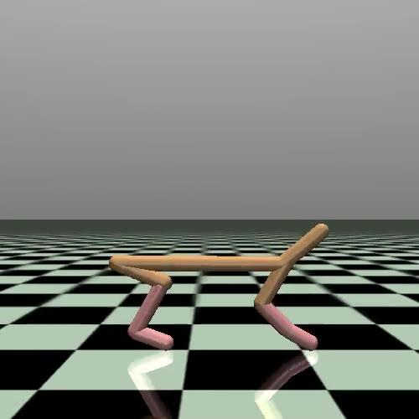
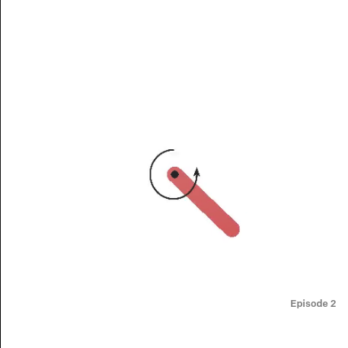
Experiments
Notes:
To test our framework, we perform experiments upon the following 6 environments.
The CartPole environment involves balancing an inverted pendulum by making discrete actions of LEFT or RIGHT. It has a 4 dimensional state.
CartPole v0 has a maximum trajectory length of 200, while CartPole v1 has a maximum trajectory length of 500
LunarLander –v2 is an environment in which we must land a spacecraft upright within a marked zone. The reward function is complex – there is a penalty for time taken to land, usage of engine fuel to prevent downward movement and not landing upright. The only positive rewards are obtained if the spacecraft lands within the correct zone, and if it lands upright, and the environment is only considered solved if it can solve both objectives. The normal version is a discrete environment with 4 actions, while the continuous version has an action dimension 2.
Pendulum v0 is a continuous environment where the agent must learn to perform a sequence of swinging actions to balance the bar in the upright position.
HalfCheetah 2 is a continuous environment where the agents must learn to move forward with force inputs given to the joints

Slide 12
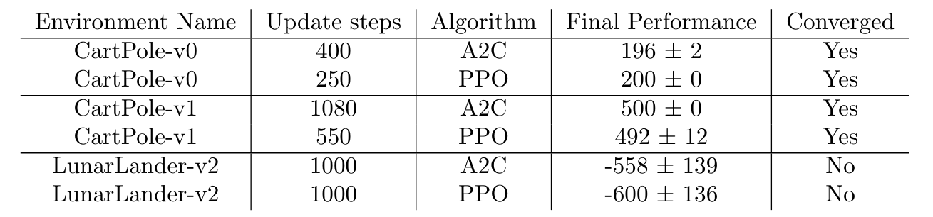
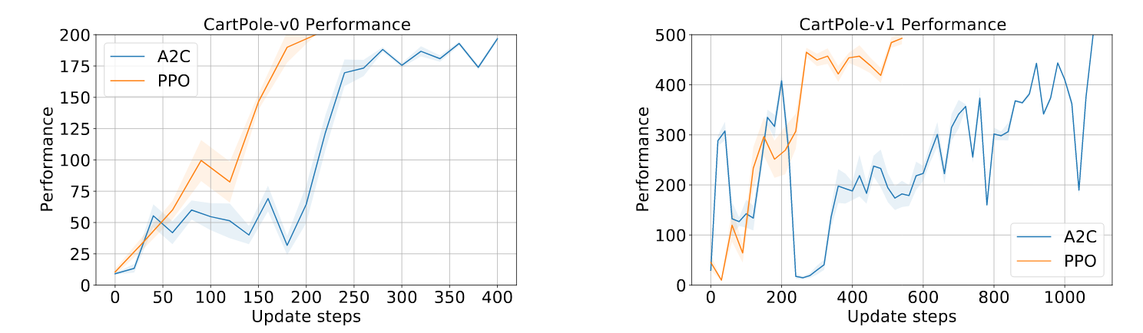
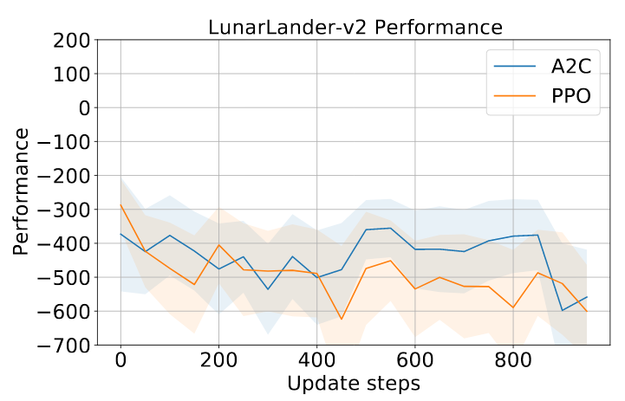
Results – On-policy – Discrete Environments
Notes:
Notes
CartPole envs are the only discrete environments solved by our framework
The training is shown to sustain also in the longer version of CartPole, showing that a stable policy has been learnt.
Exploration found to be a problem in the LunarLander environment.
Integrating entropy does not help increase the performance.

Slide 13
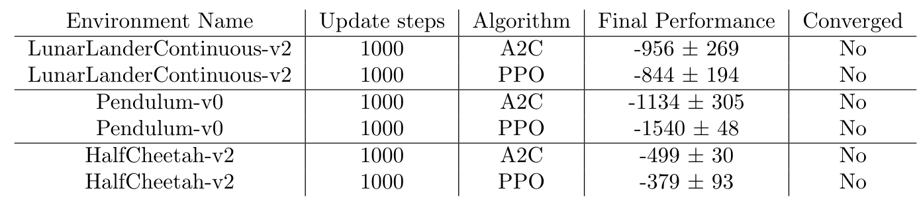
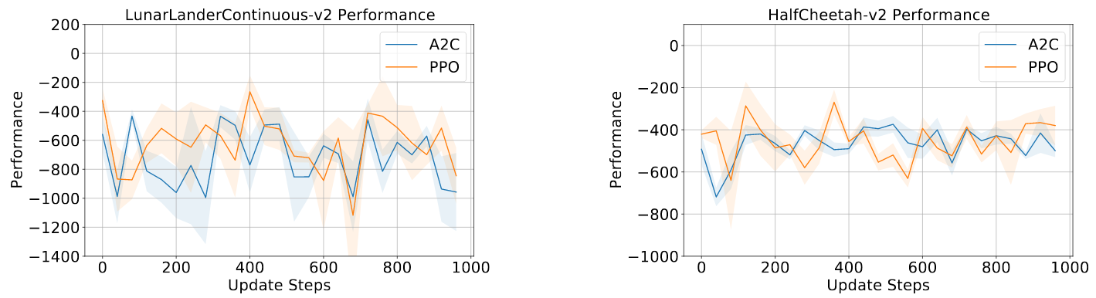
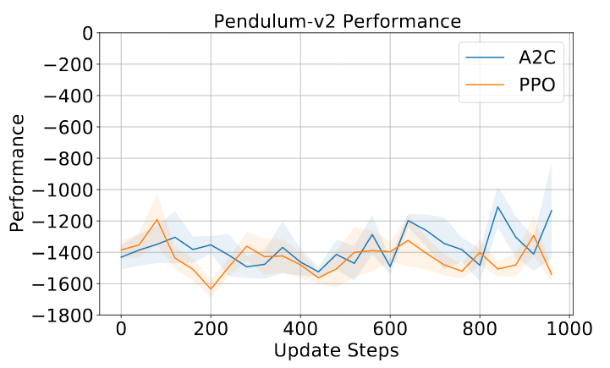
Results – On-policy – Continuous Environments
Notes:
Notes
None of the continuous environments solvable using off-policy
All 3 continuous environments need a complex sequence of actions which they are unable to identify in new trajectories
We need a workaround for using randomly initialized policies for training.
Off-policy is a natural choice

Slide 14
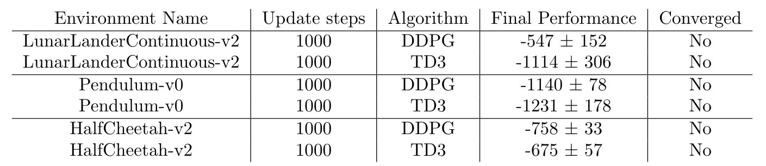
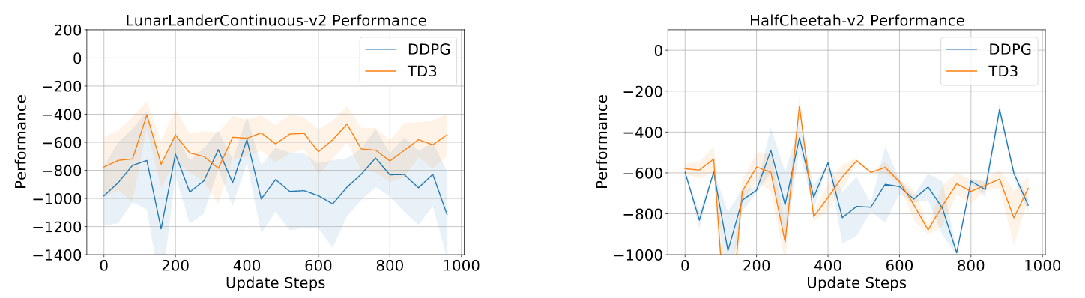
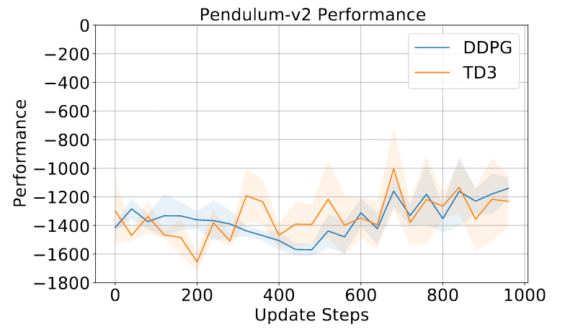
Results – Off-policy – Continuous Environments
Notes:
Notes
Off-policy RL algorithms show much worse performance, even though the data contains a significant distribution of actions.
In all cases, the performance is usually worse than an agent performing random actions

Slide 15
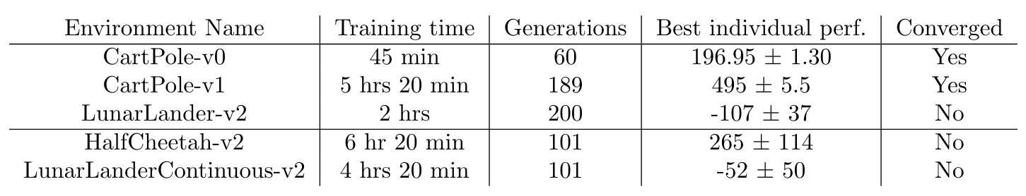
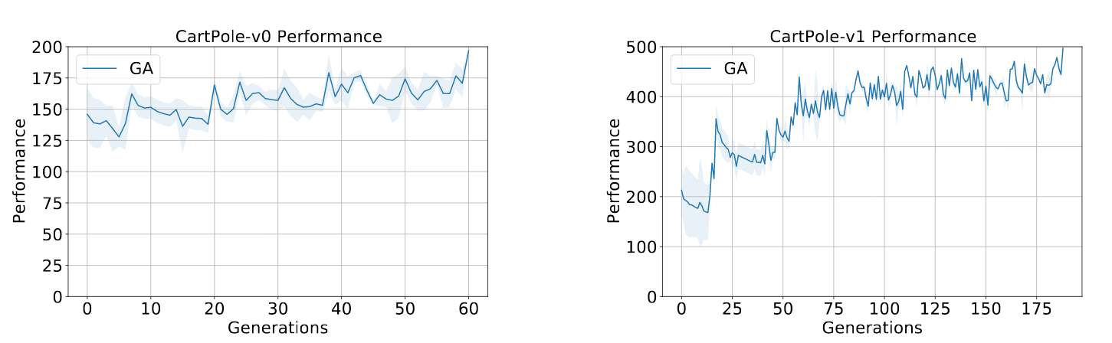
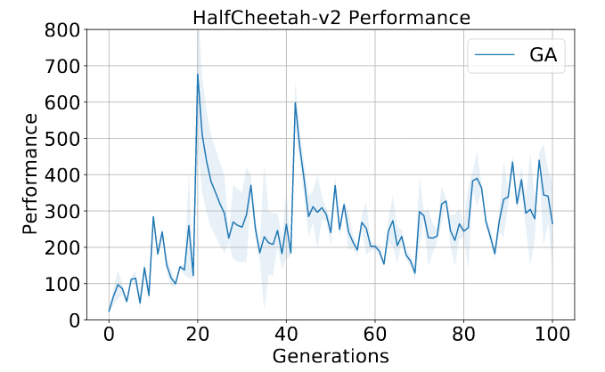
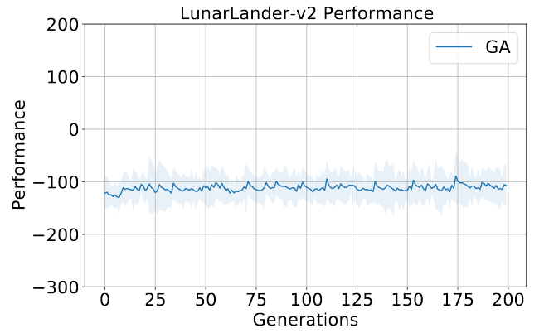
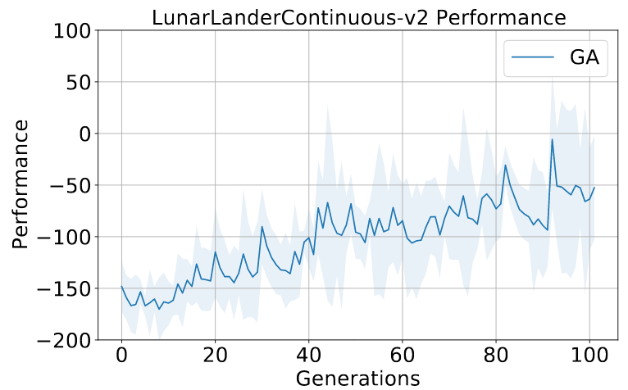
Results – Genetic Algorithms
Notes:
Notes
It is not clear whether the Trainer Algorithm is able to transfer complex policies quickly.
Genetic Algorithms are gradient-free optimization, and can surpass gradient issues
While computationally expensive to train completely, preliminary results show that the Trainer is able to reach significant results in multiple environments, thus showing viability

Slide 16
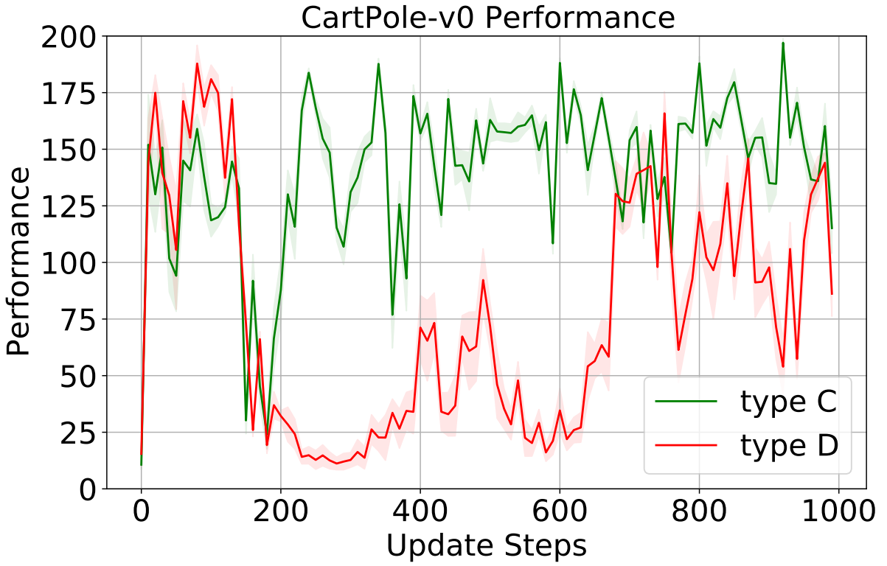
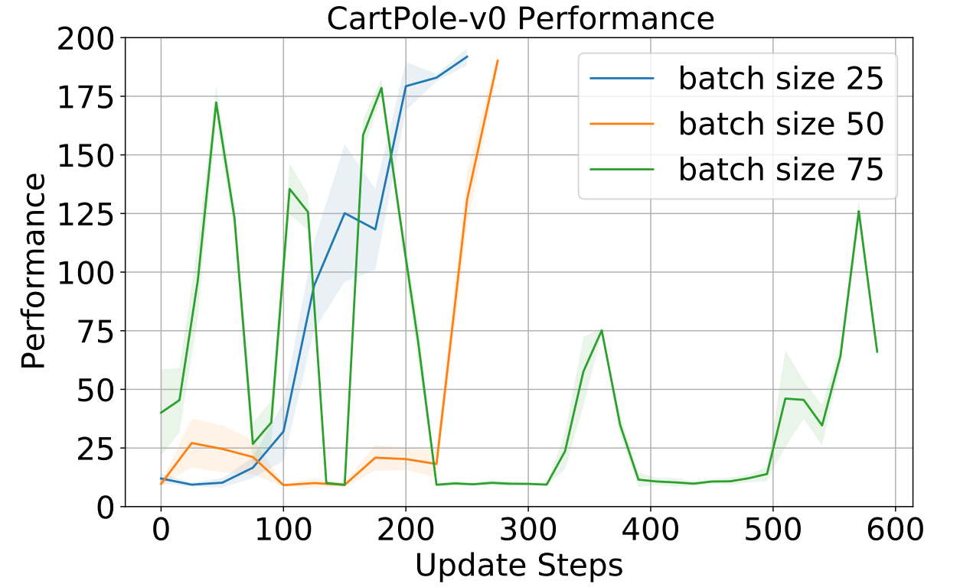
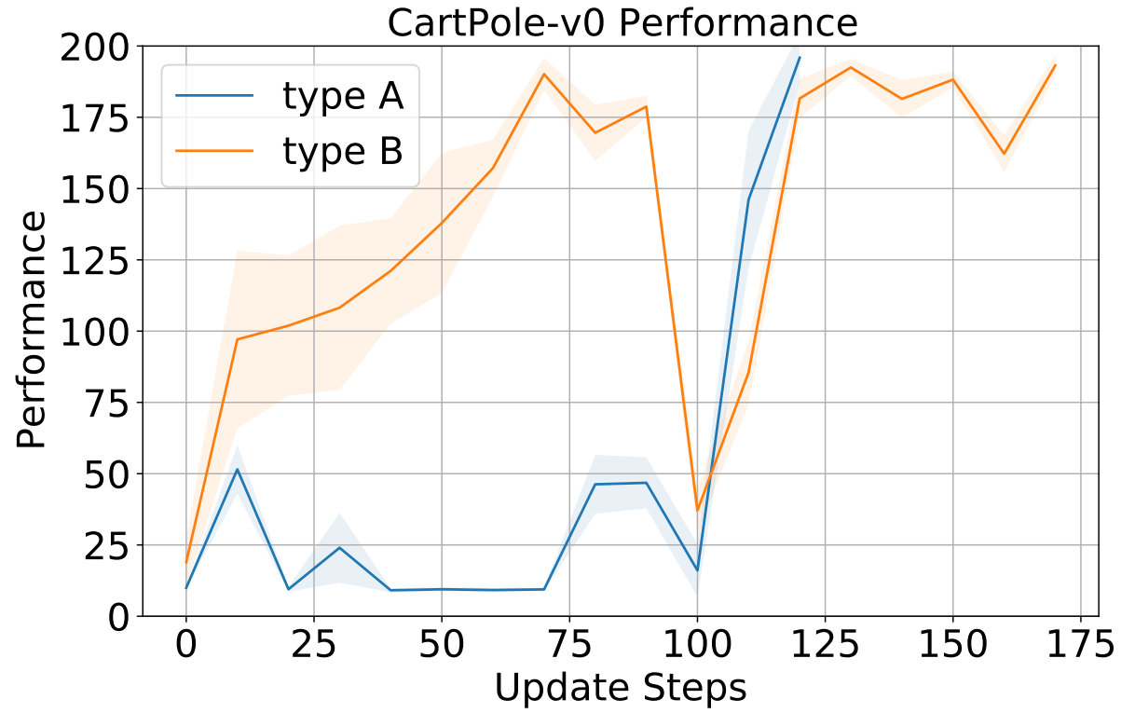
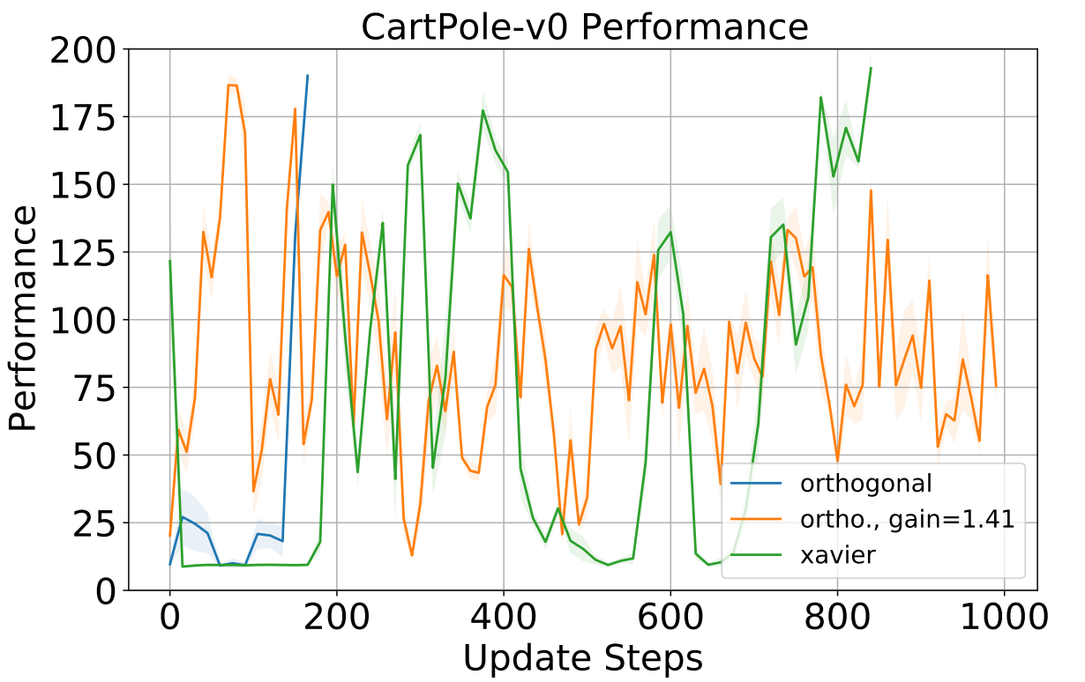
Impact of Architecture Choices in the CartPole environment
Initialization of Random Actor Parameters
Orthogonal scheme
Orthogonal scheme with gain 1.41
Xavier scheme
Allowed variation in Architecture of Random Actors
A - Single Linear layer of fixed size 64
B - Single Linear layer of size randomly chosen in range [30, 80]
C – Either 1 or 2 Linear layers randomly chosen in range [30, 80]
D – Either 1 or 2 Linear layers with each layer of size randomly chosen in range [30, 200]
Batch size in Trainer input
Notes:
We consider the impact of certain architecture choices in the framework for the CartPole environment, showing how training is influenced. Choices are chosen from previous analysis in literature done with respect to on-policy RL
The initialization of the randome Actors is a major influence in the speed of training.
The number of data samples generated by the Trainer is a major influence. There is a sweet spot for training that differs across environments.
The range of Architecture choices available for the Actor slows down meta-learning quite a bit
More choice leads to slower training. In some cases, too much variation leads to no convergence.

Slide 17
Observed Problems
On-Policy Algorithms
Newly-initialized agents do not perform extensive exploration!
Gradients are quite unstable, and could not be fixed
Off-Policy Algorithms
Extremely sensitive to out-of-distribution data
Q-value estimators experience catastrophic failures
Genetic Algorithms
Slow performance through extensive testing
Notes:
Notes
- On-policy algorithms do suffer from stability issues
- We attempted to use Off-policy to bypass the exploration issue
We ran into a divergence problem
Having a common Q-function estimator might cause problems with respect to the Actor itself.
Such actors and agents are also highly sensitive to out-of-distribution data, and so we hypothesize that our policy transfer process is unstable
Genetic Algorithm results show that our framework itself is optimizable

Slide 18
Conclusion
Framework for optimizing efficient training environments (rapid policy transfer) built.
Found training stability issues in direct policy gradient approaches that involve exploration
Genetic Algorithm empirically shown to optimize Trainer in complex cases
Notes:
Our framework has the following features
- Agnostic to a large variety of Actor architectures
- Supporting both Discrete and Continuous Action Environments
Supporting direct integration with many state-of-the-art model-free RL algorithms

Slide 19
Future Scope
Learning from Demonstrations is a major alternative to use prior data,
Offline RL could solve exploration problem
Once trained, Trainer models could be tested in multi-task RL
Notes:
- Learning from Demos assumes consistent noise-free demonstrations, but may be beneficial in replacing the loss component in our framework.
- Alongside On-Policy and Off-Policy, Offline RL stands apart
Offline RL restricts any further interaction with the environment, and present research focuses on reducing the instability issues encountered in training upon previously obtained trajectory data
Multi-task RL could initialize Agents as required, depending upon the task to be performed.

Slide 20
Thank you!
Questions?

Slide 21


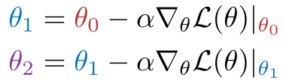
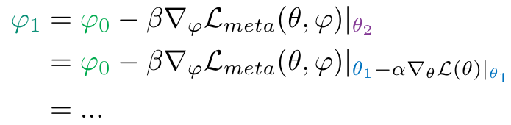
Backup Equation Slides (Not part of Presentation)
Outer loop
Meta-Parameters
Inner loop
Model Parameters
Model Parameters (influenced by meta-parameters)
Meta Loss
Loss
Batch data sample from a single supervised task
Batch trajectory data from a single RL environment
Batch data samples from multiple supervised tasks
Batch trajectory data from multiple RL environments
Notes:
Metalearning vs MAML vs our case

Slide 22
Methodology – Trainer Input
For Discrete Action RL Environments
For Continuous Action RL Environments
Noise Vector
Action Vector
Action Dimension
0.04 | 0.6 | -0.01 | .. | 0.42
-0.78 | -1.92 | -0.2 | .. | -0.57
0.5 | 1.2 | 0.7 | .. | -0.73
.. | .. | .. | .. | ..
0.13 | -0.09 | 1.1 | .. | 1.6
1.4 | -0.12 | 0.87 | .. | -0.14
-0.9 | 0.54 | -1.8 | .. | 0.99
0.04 | 0.6 | -0.01 | 0 | 0 | 0
-0.78 | -1.92 | -0.2 | 0 | 0 | 0
0.5 | 1.2 | 0.7 | 0 | 0 | 0
.. | .. | .. | .. | .. | ..
0.13 | -0.09 | 1.1 | 1 | 1 | 1
1.4 | -0.12 | 0.87 | 1 | 1 | 1
-0.9 | 0.54 | -1.8 | 1 | 1 | 1
1 | 0
1 | 0
1 | 0
.. | ..
0 | 1
0 | 1
0 | 1
Batch Size
Batch Size
Batch Size
Input
Output

